Slide 1

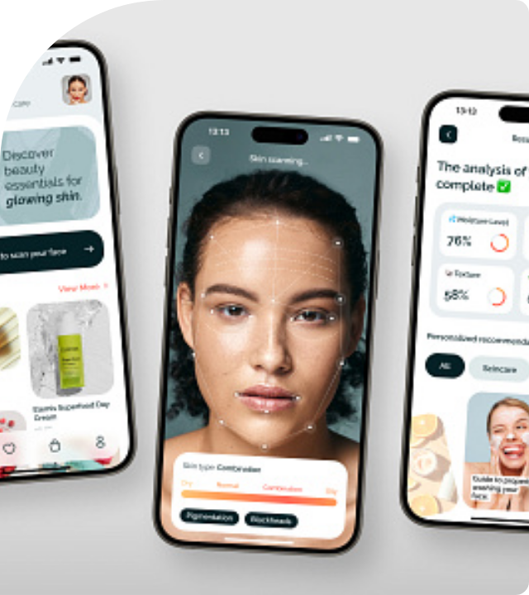
DermaCare AI
Intelligent Skin Disease Detection System
A cutting-edge project leveraging Deep Learning to democratize access to dermatological care.

Slide 2

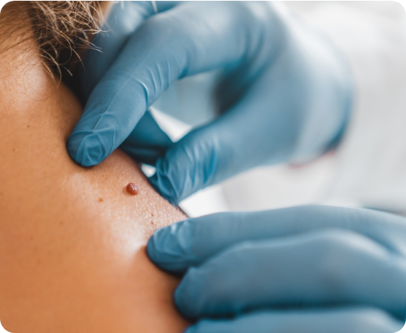
Project Overview
Problem Statement
Access to dermatologists is often limited by geography and high consultation costs. Early detection is crucial but frequently delayed.
Objective
To create an accessible, AI-powered mobile application that allows users to scan skin lesions and receive instant probability assessments.
Target Users
•
General Public (Home Use)
•
Remote Healthcare Workers
•
Medical Students

Slide 3









Technology Stack
Frontend
Backend
AI / ML
React-Native
Django (Python)
TensorFlow & CNN
Built for cross-platform compatibility (iOS & Android) ensuring a smooth, responsive user interface.
Robust REST API handling image uploads, user authentication, and serving model inference results.
Convolutional Neural Networks trained on dermatological datasets for high-accuracy classification.

Slide 4
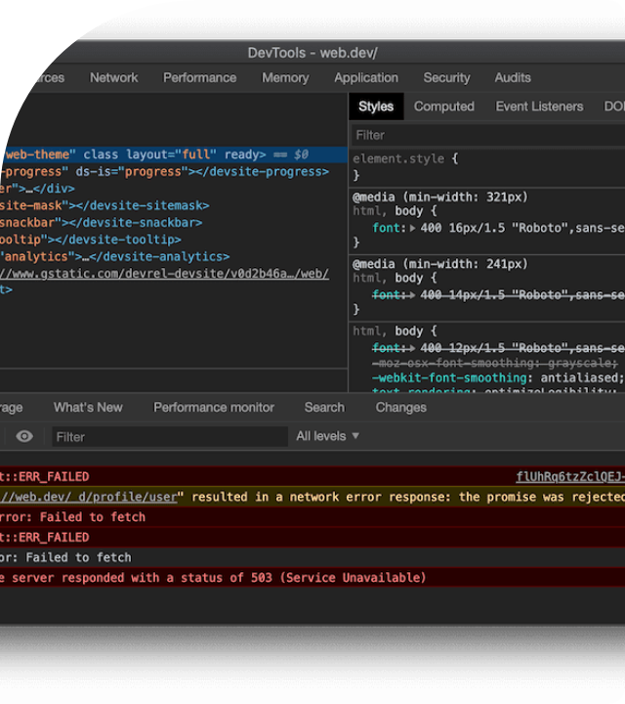
Challenges & Solutions
Data Imbalance
Problem: The dataset contained significantly more benign images than malignant ones.
Solution: Applied aggressive Data Augmentation (rotation, flipping, zooming) to balance the classes during training.
Image Quality
Problem: User-uploaded photos varied wildly in lighting and focus.
Solution: Implemented a client-side "Sharpness Check" in React Native before allowing upload.

Slide 5
Future Scope
Telemedicine Integration Allow users to directly share scan reports with verified dermatologists for a professional second opinion.
Offline Mode Deploy a compressed TFLite model directly on the device for real-time inference without internet connectivity.
Multilingual Support Add support for regional languages to make the tool accessible to rural populations.

Slide 6

Conclusion
Project Summary
Learning Outcomes
We successfully developed "DermaCare AI," a functional full-stack application connecting a React Native frontend with a Django backend.
•
Deepened understanding of CNN architectures and image processing pipelines.
•
Mastered API integration between Python (Django) and JavaScript (React Native) environments.
The system demonstrates how AI can be effectively bridged with consumer mobile technology to solve real-world healthcare challenges.
•
Gained experience in handling medical data privacy and storage best practices.

